Slide 1
Data Visualization Fuad Bin Saif Final Project Presentation Exploring the Urban dynamics through datasets made of Hate crime, Arrest, shooting, eviction and collision of New York City
U41393121
Email: fuadbinsaif@usf.edu

Slide 2
Research Questions
Where were the arrests made in terms of location in NY city and did any race have precedence over other races?
What was the age range of the arrests that were made? What was the number in terms of gender?
What was the scenario of arrest made and shooting in NYC?
For vehicle collisions, what factors contributed towards collision of different types of vehicles? Analize the visuals.
What trend do we see in arrest, shooting, hate crime and collision?
What does a borough wise comparative analysis of arrest, shoot, collision, eviction and hate crime look like? Which borough had the highest percentage of the variables? What can we infer from the visuals?

Slide 3
Methodology:
All my data was collected from data.gov and CityPopulation.
Arrest: This data contains various information like arrest location, date, precinct, borough etc. about arrests made in in New York city from the year 2006.
Shooting: This dataset contains all shooting that took place in NY city from the year 2006 to 2022. This dataset contains columns like borough, occur date, victims’ race, victims’ sex etc.
Hate Crime: This is the dataset about hate crime committed in NY city from the year 2019 to 2023. This contains various information about hate crime which includes borough, Motive description, offense description etc.
Eviction: This data is about the evictions made in NY city from 2017 to 2023. This dataset also has various information about the eviction.
Collision: This is the car collision data of NY city from the year 2012 to 2023. This dataset contains information about the collision vehicle and factors influencing the crash.

Slide 4
Data Processing
The data sets had several columns of data that were not necessarily needed for our work.
To create a joint between data I had to change the name of Borough data as the spelling were not the same in all cases
Arrests<- read_csv("NYPD_Arrests_Data__Historic_ - Copy.csv")
colnames(Arrests)[c(9)] <- c("BORO")
unique(Arrests$`BORO`)
Arrests <- Arrests %>%
filter(!is.na(BORO))
Arrests <- Arrests %>%
mutate(BORO = case_when(
BORO == 'B' ~ 'BRONX',
BORO == 'K' ~ 'BROOKLYN',
BORO == 'M' ~ 'MANHATTAN',
BORO == 'Q' ~ 'QUEENS',
BORO == 'S' ~ 'STATEN ISLAND',
TRUE ~ BORO
))
write.csv(Arrests, "Arrest.csv", row.names = FALSE)

Slide 5
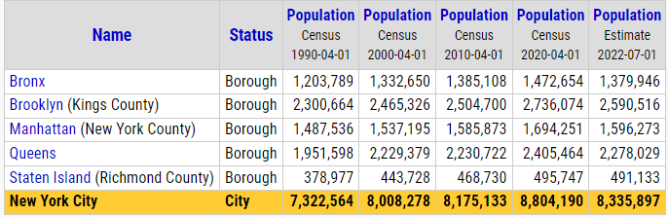
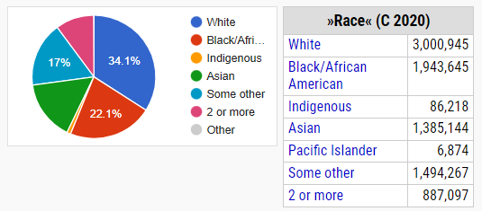
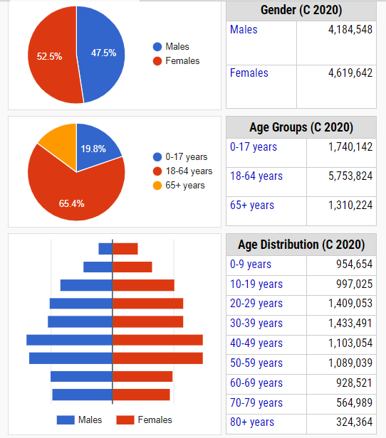
Analysis Populations considerations

Slide 6
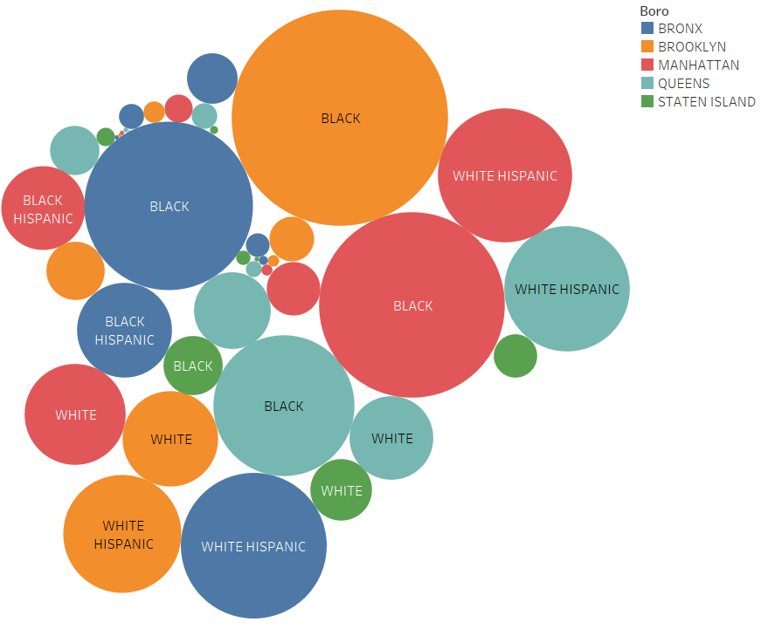
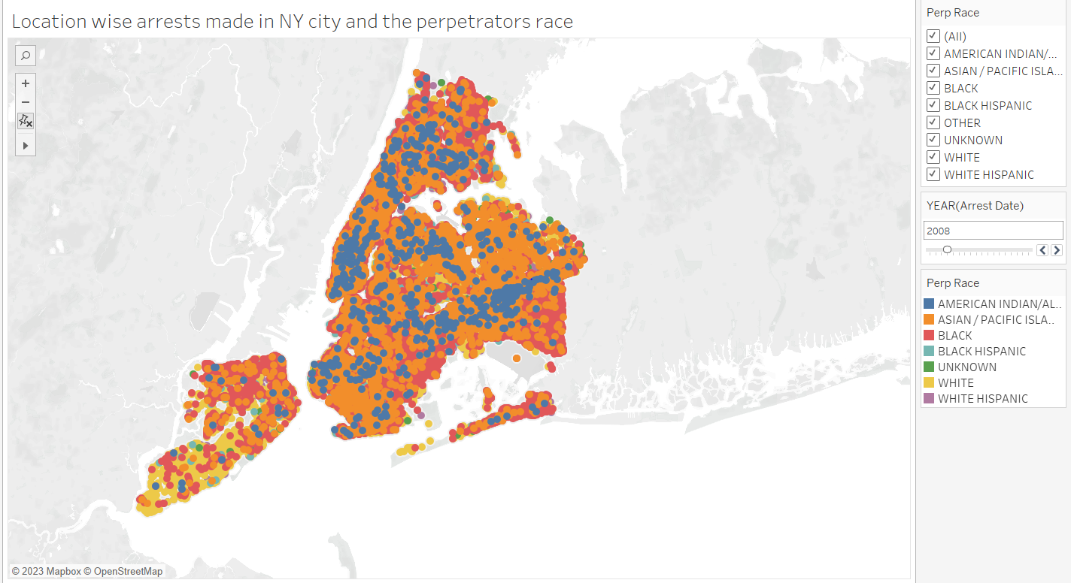
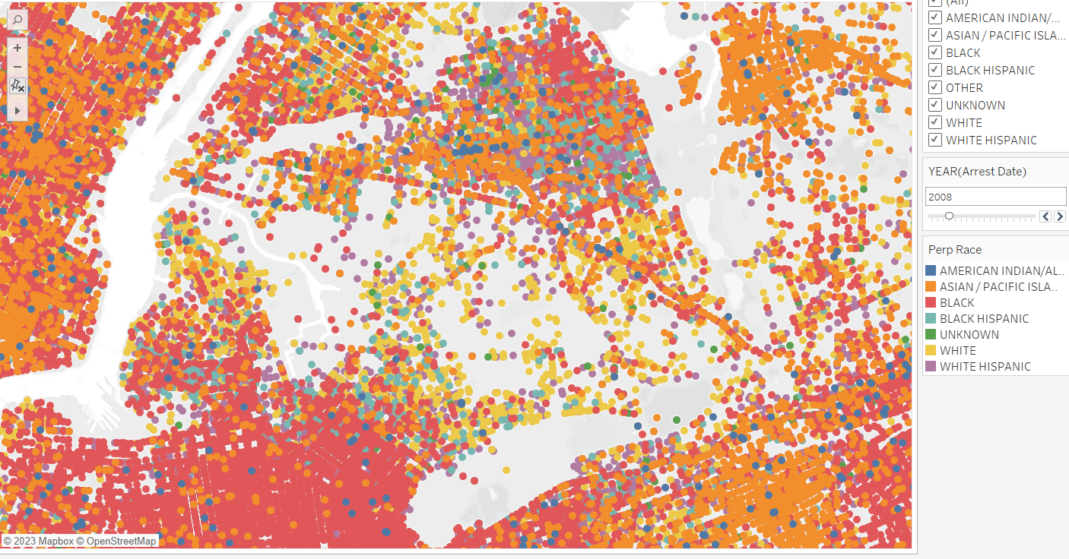
1) Where were the arrests made in terms of location in NY city and did any race have precedence over other races?

Slide 7
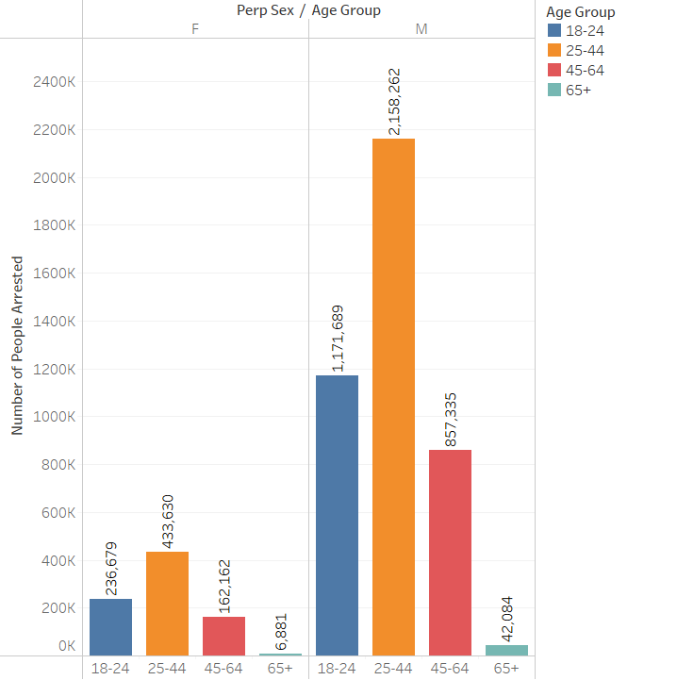
2. What was the age range of the arrests that were made? What was the number in terms of gender?

Slide 8
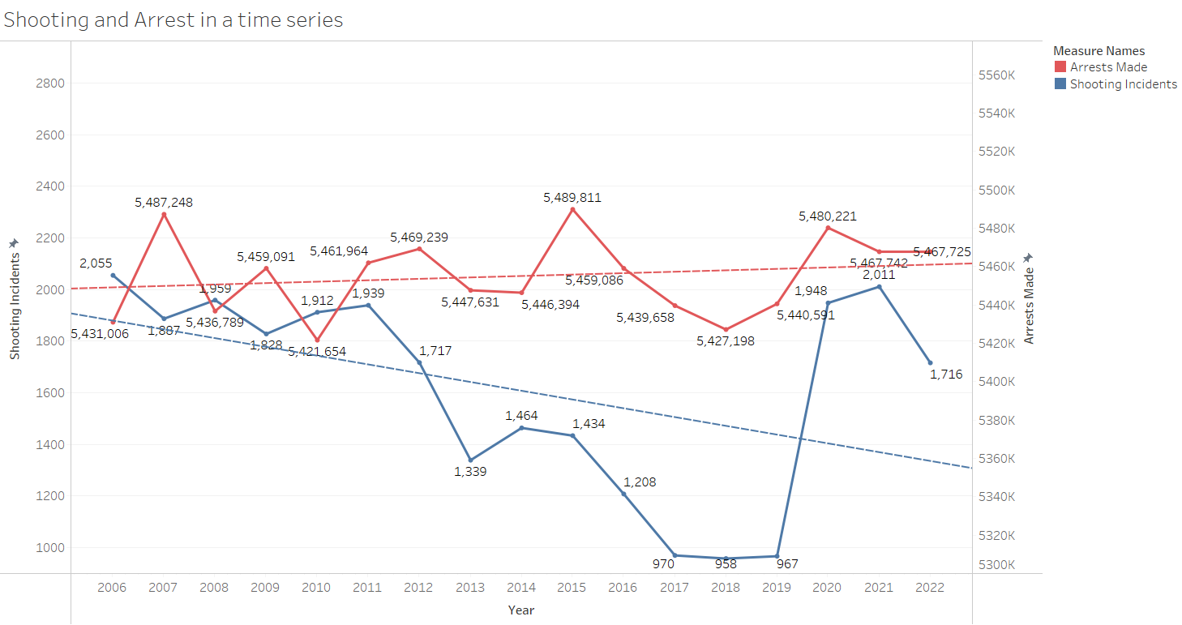
3. What was the scenario of arrests and shooting in NYC? Is there any relationship between shooting and arrest in NY city?

Slide 9
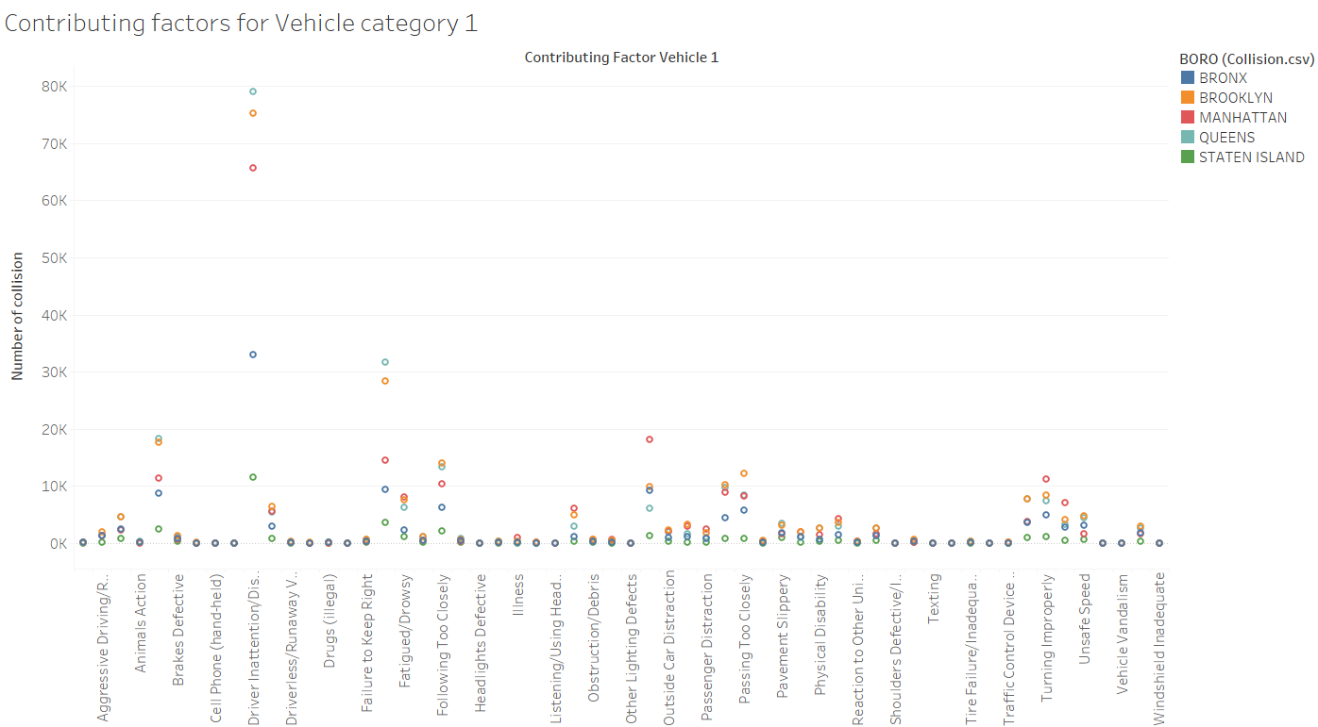
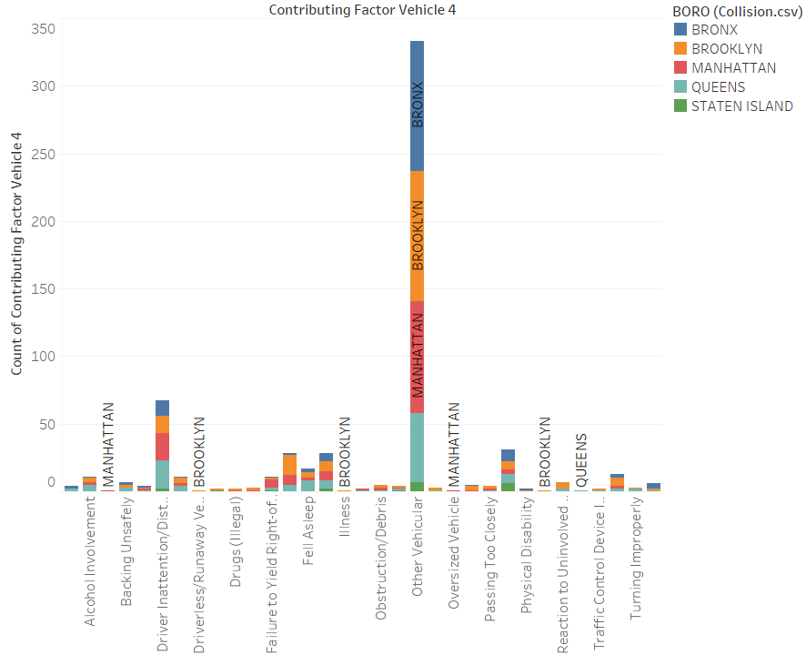
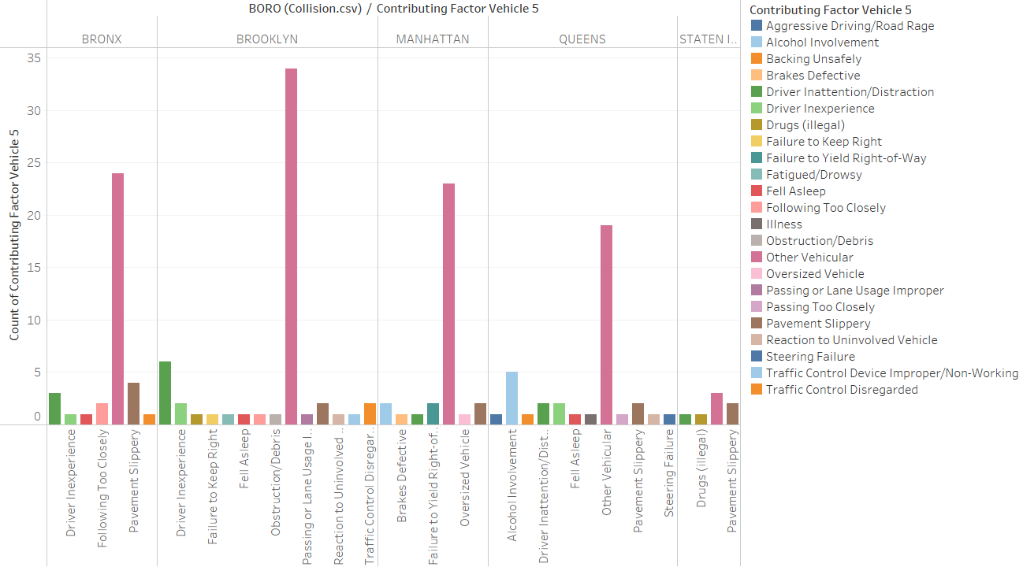
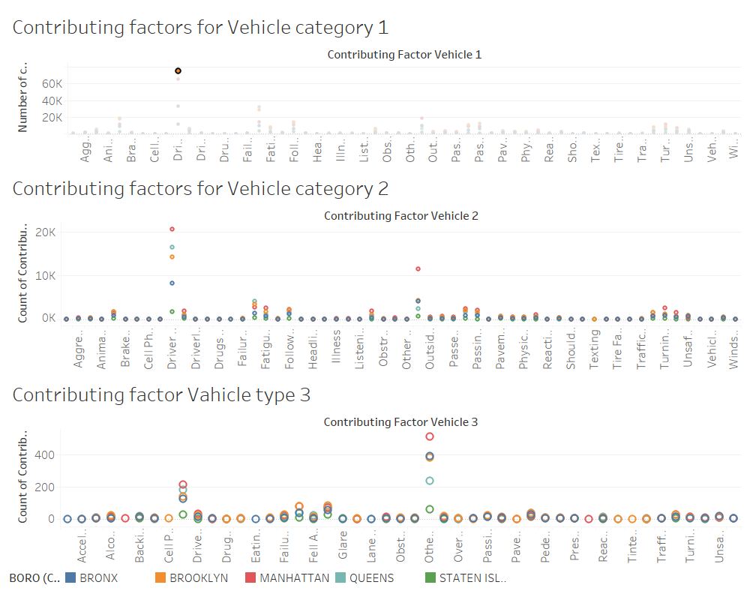
4. For vehicle collisions, what factors contributed towards collision of different types of vehicles? Analize the visuals.

Slide 10
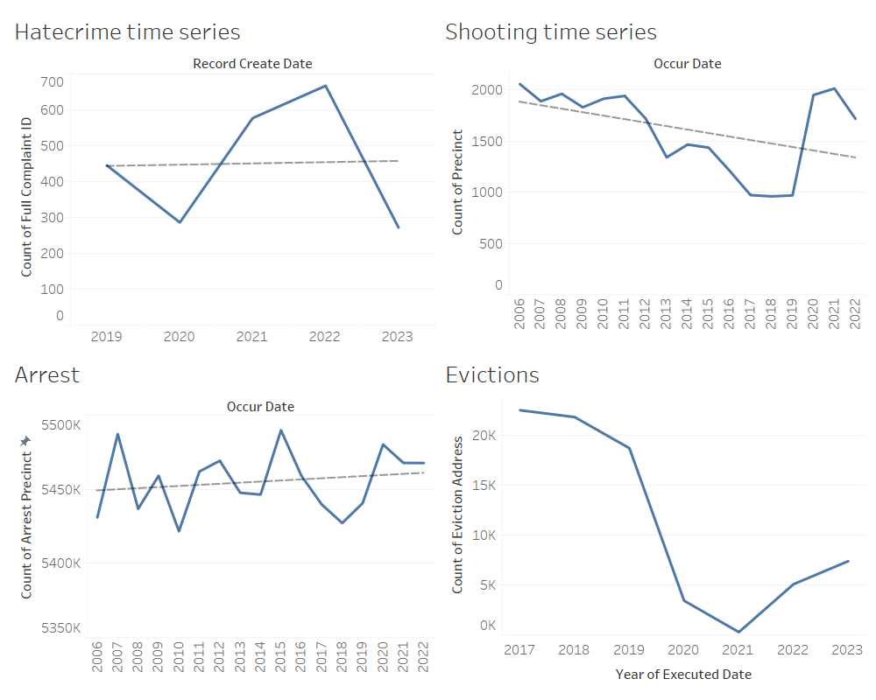
5. What trend do we see in arrest, shooting, hate crime?

Slide 11
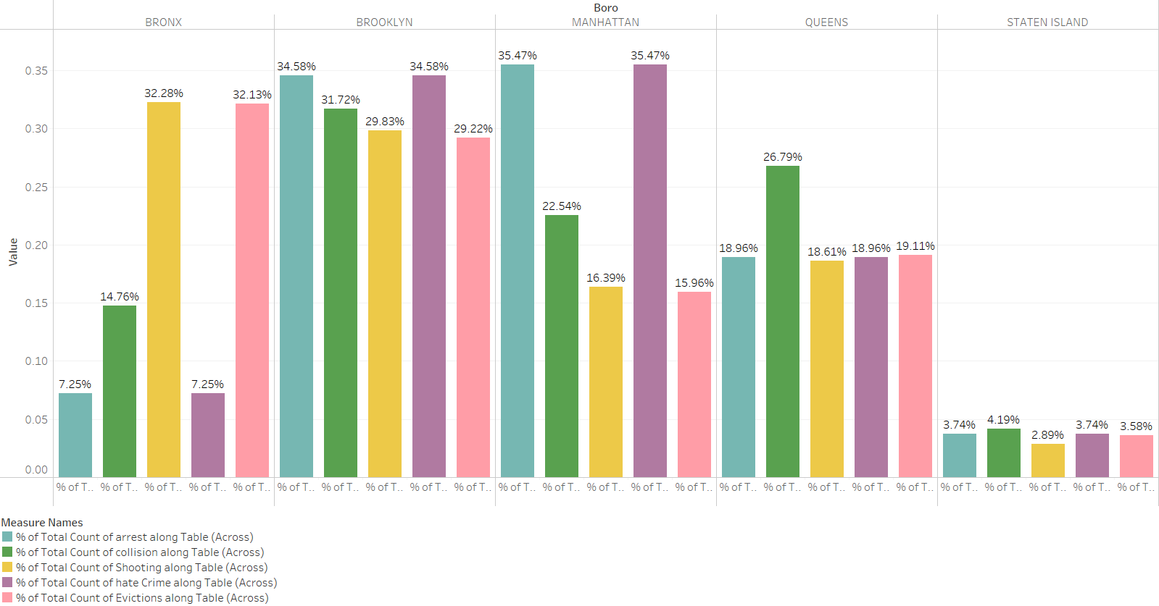
6. What does a borough wise comparative analysis of arrest, shoot, collision, eviction and hate crime look like? Which borough had the highest percentage of the variables? What can we infer from the visuals?

Slide 12
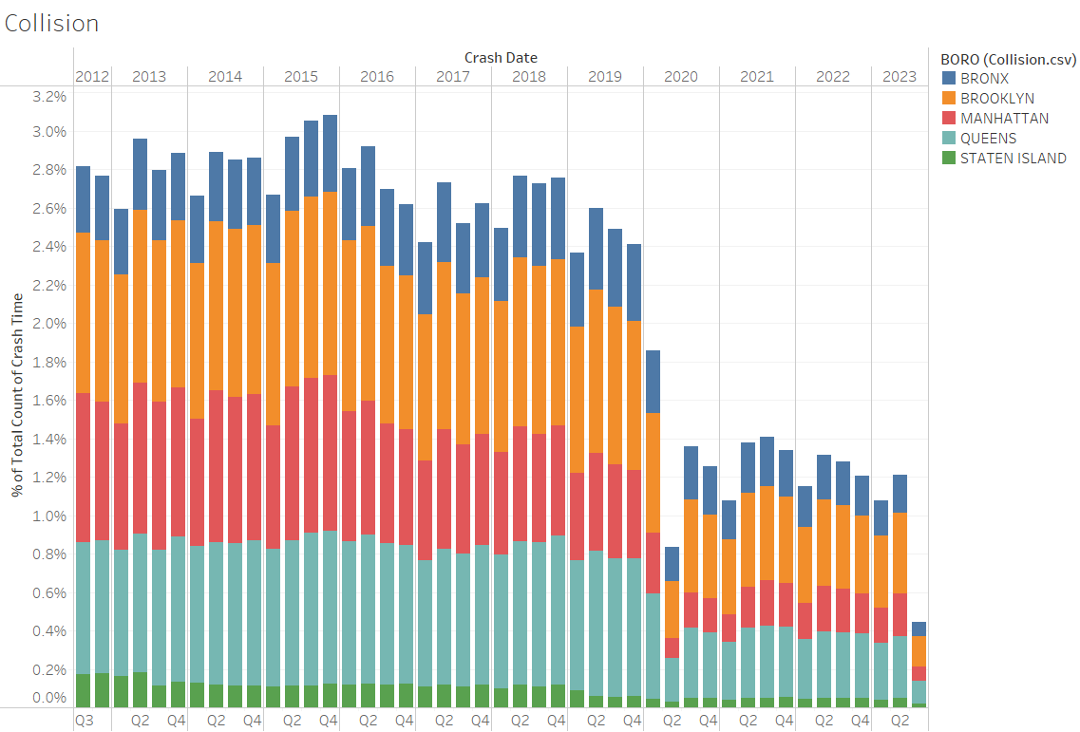
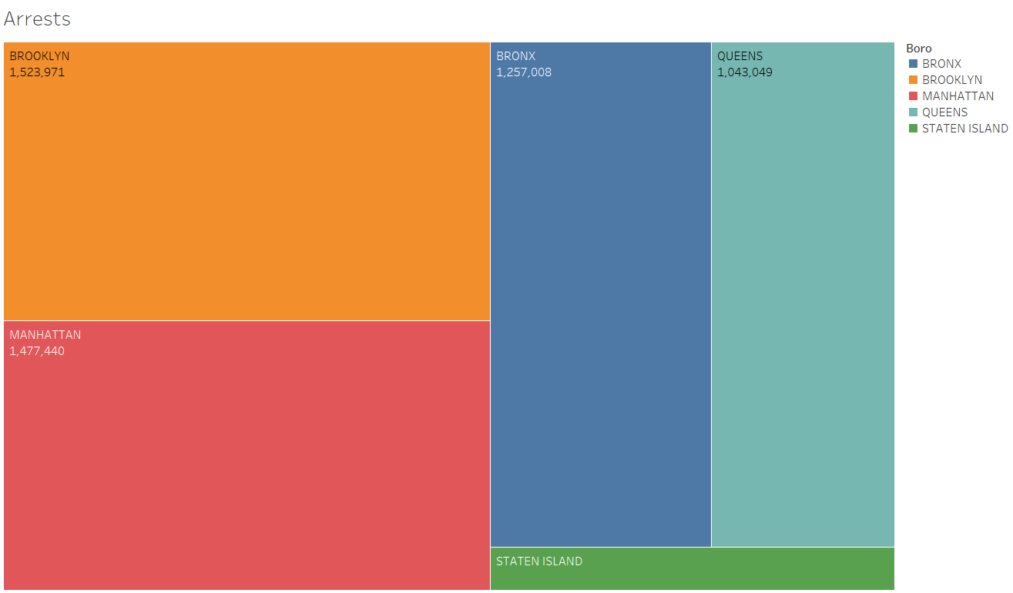
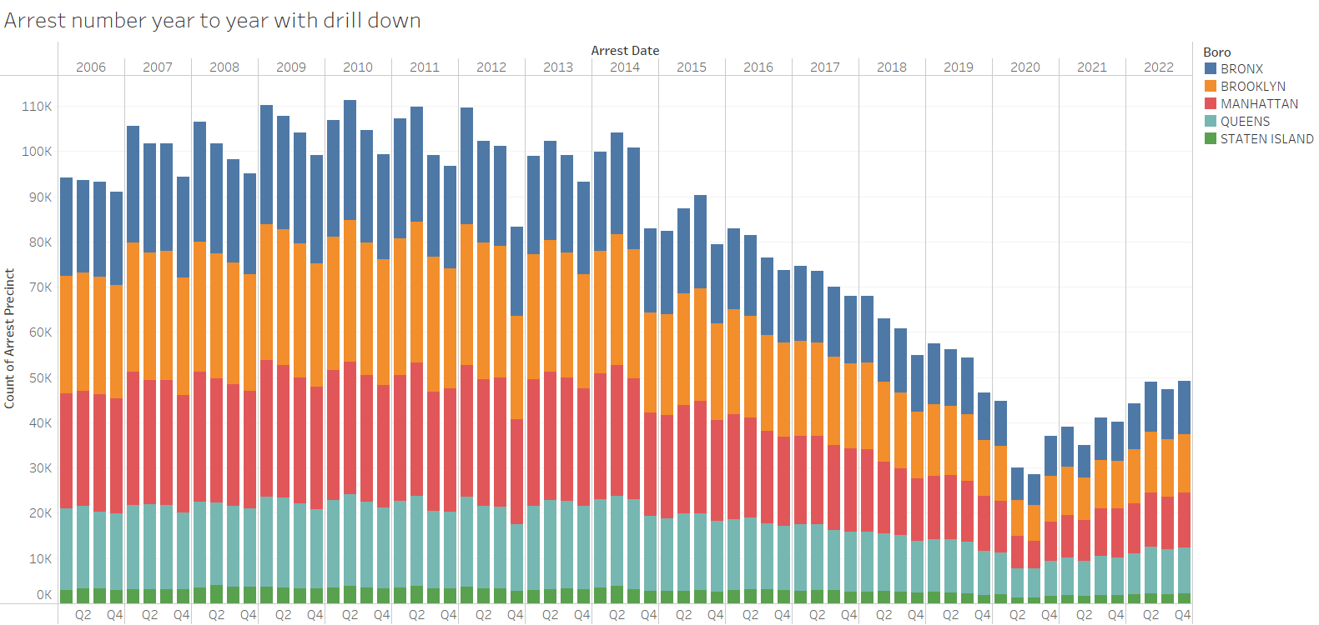
6. What does a borough wise comparative analysis of arrest, shoot, collision, eviction and hate crime look like? Which borough had the highest percentage of the variables? What can we infer from the visuals?

Slide 13
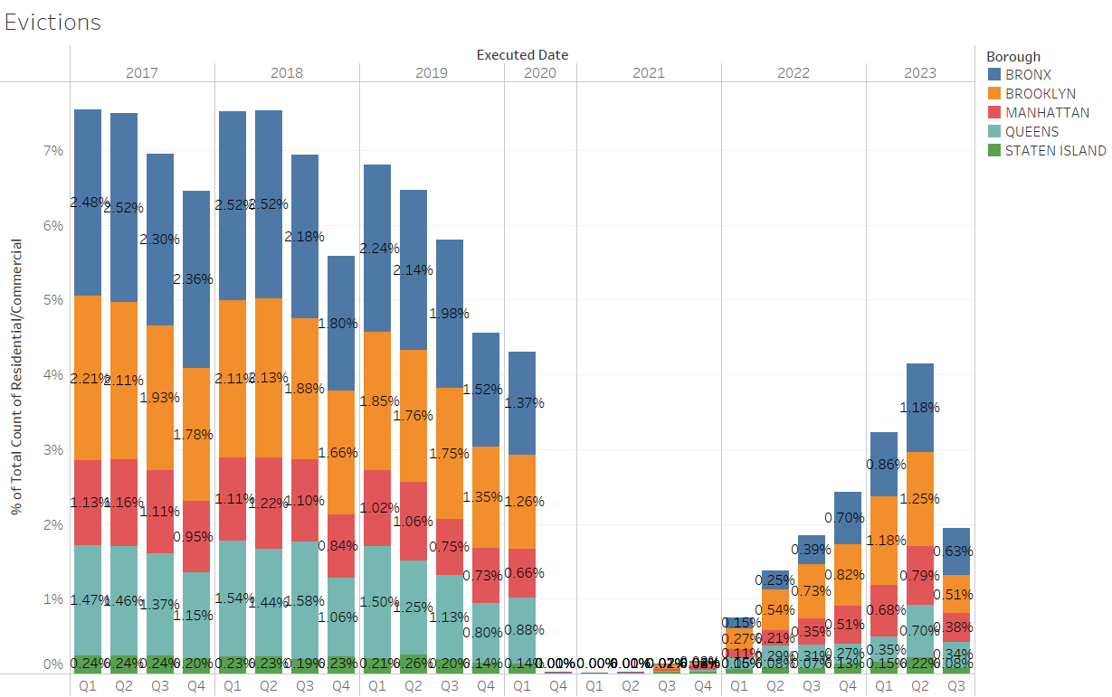
6. What does a borough wise comparative analysis of arrest, shoot, collision, eviction and hate crime look like? Which borough had the highest percentage of the variables? What can we infer from the visuals?

Slide 14
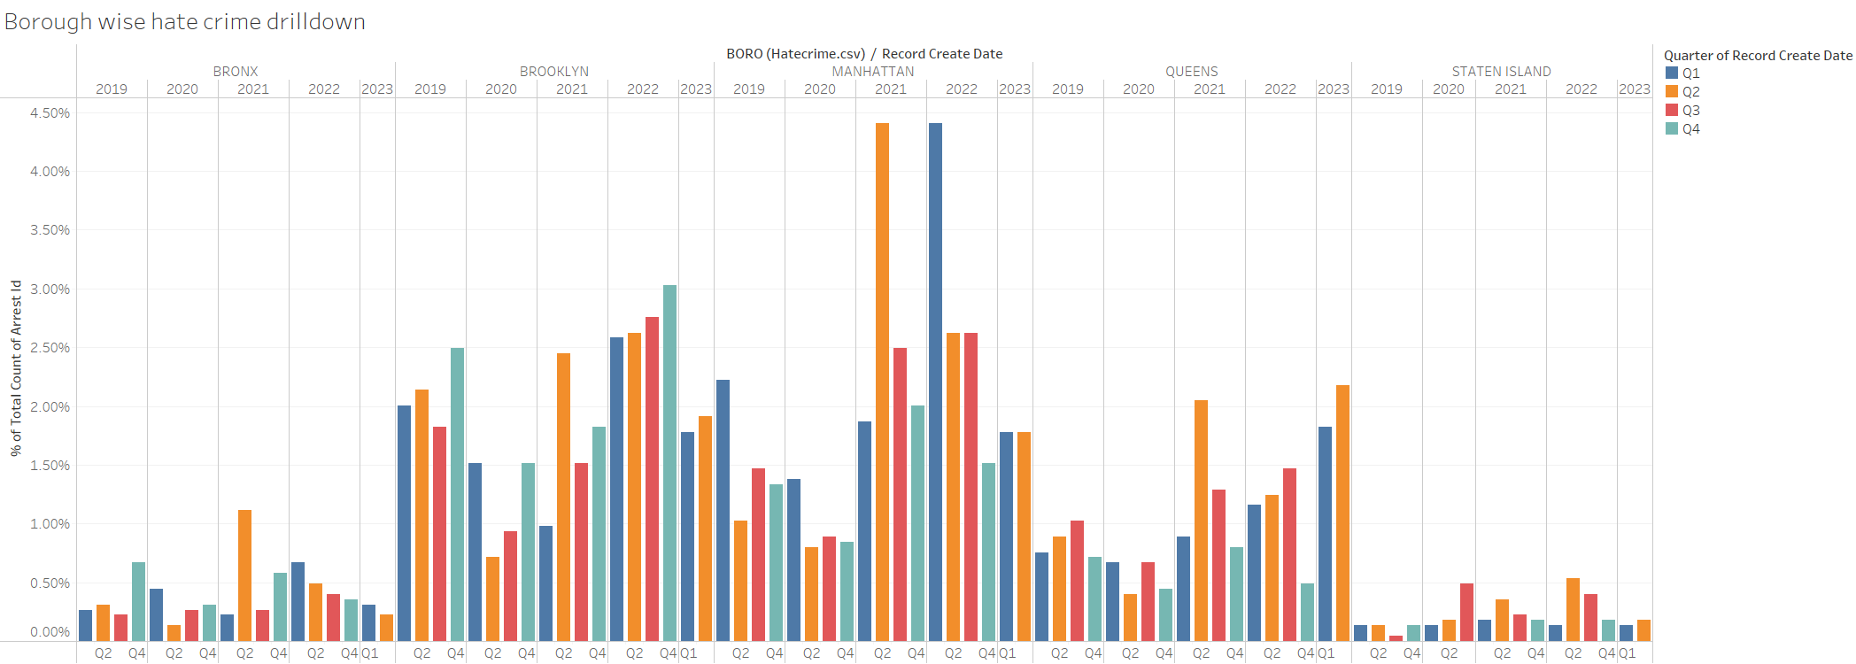
6. What does a borough wise comparative analysis of arrest, shoot, collision, eviction and hate crime look like? Which borough had the highest percentage of the variables? What can we infer from the visuals?

Slide 15
Additional research questions:
What was the crime scenario like in areas where arrests had the highest density?
Could there be an economic factor that contributed to arrests in NY city?
If we normalize the dataset, then could we expect to see a different trend?
If hate crimes were plotted against evictions will there be any co relation?
What was the reason for such high collision rate for vehicle type one?
What is the main cause of driver distraction that is creating so many accidents?

Slide 16
Thank You

